Slide 1
Minority Health Social Vulnerability Index
Toyin Ola | May 11, 2023

Slide 2
Introduction
The Minority Health Social Vulnerability Index (Minority Health SVI) is a database that includes variables associated with a community's ability to prepare for and recover from disasters and public health emergencies.
Using these variables, communities can be compared to each other and ranked to provide a measure of relative social vulnerability.
The Minority Health SVI extends the CDC/ATSDR SVI by including specific ethnicity, race, and language data as well as factors like health care infrastructure, chronic disease prevalence, and internet access.
This presentation highlights Asian American (AA), Native Hawaiian (NH), Pacific Islander (PI), and limited English proficiency (LEP) populations in high-vulnerability counties.
Toyin Ola
Notes:
The Minority Health SVI database contains only county-level data, not Census tract-level data.

Slide 3
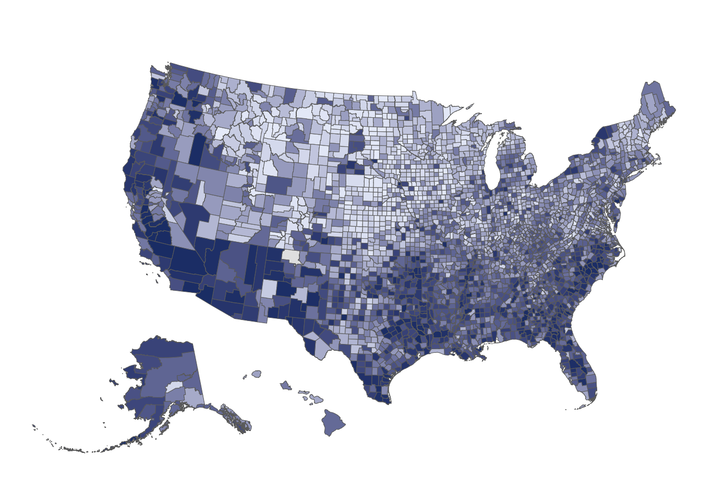
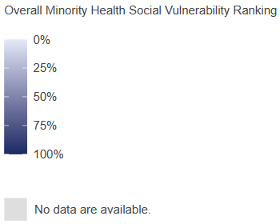
Toyin Ola
Notes:
There is one county with no Overall Social Vulnerability Ranking: Rio Arriba County, NM (FIPS code 35039).

Slide 4
High-Vulnerability Counties
All Counties
Here, a high-vulnerability county is a county with an Overall Social Vulnerability Ranking ≥ 0.90, indicating it is more socially vulnerable than at least 90% of all U.S. counties (90th percentile).
Of the 3,142 counties in the Minority Health SVI database, there are 315 high-vulnerability counties.
High-Vulnerability Counties
Toyin Ola

Slide 5
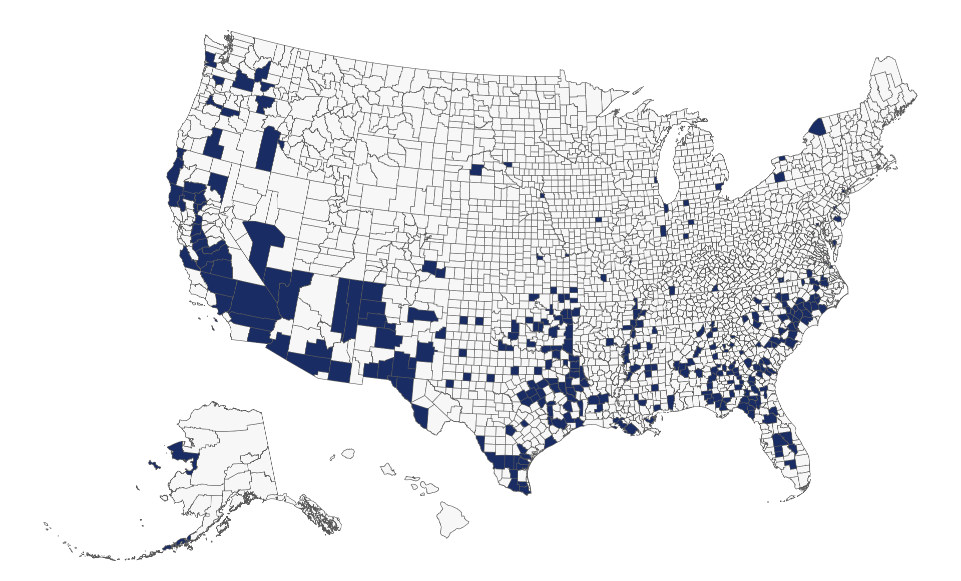
High-Vulnerability Counties
Toyin Ola
Notes:
While place-based social determinants of health can provide insights, it is important to be wary of the ecological fallacy. These data reflect the social vulnerability of a geographic area, not all people living within that geographic area. It is also key to note that counties are administrative boundaries that are not uniform in size (land area or population density).

Slide 6
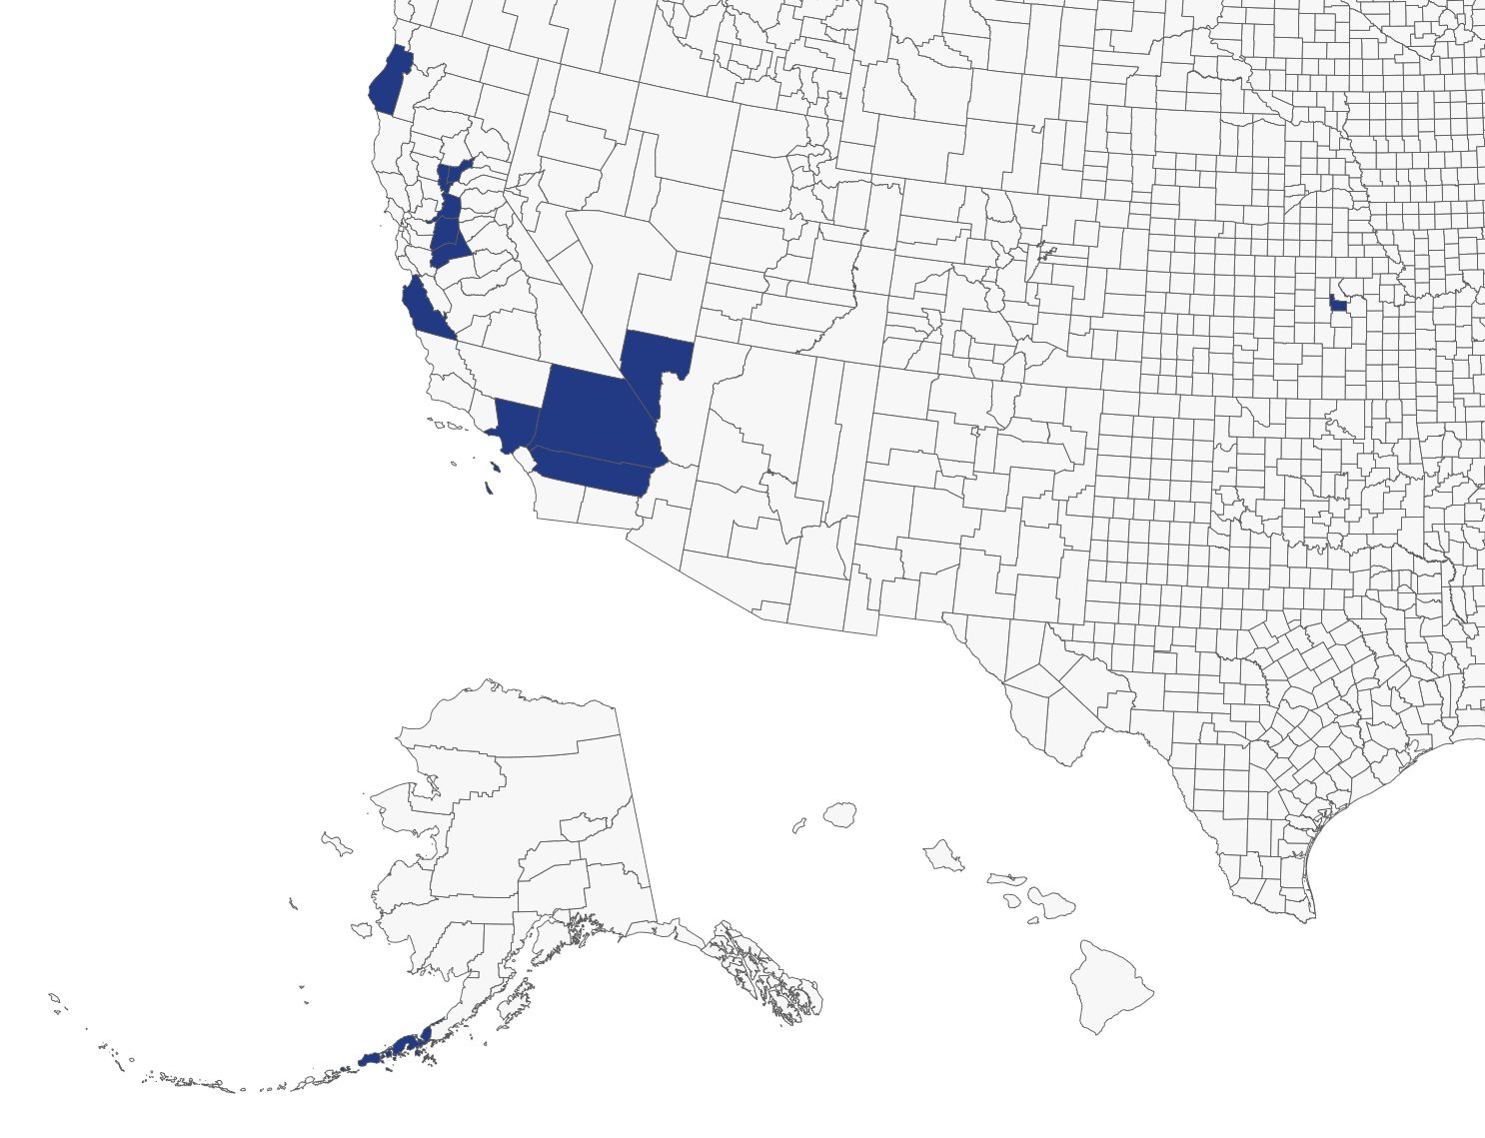
AANHPI Populations
Of the 315 high-vulnerability counties…
… 41 counties (13%) are also in the 90th percentile or higher for AA population.
… 47 counties (15%) are also in the 90th percentile or higher for NHPI population.
…. 13 counties are in the 90th percentile or higher for both AA and NHPI populations.
Toyin Ola
Notes:
Only three of the 13 counties are not in California: Aleutians East, AK; Geary, KS; and Clark, NV.

Slide 7
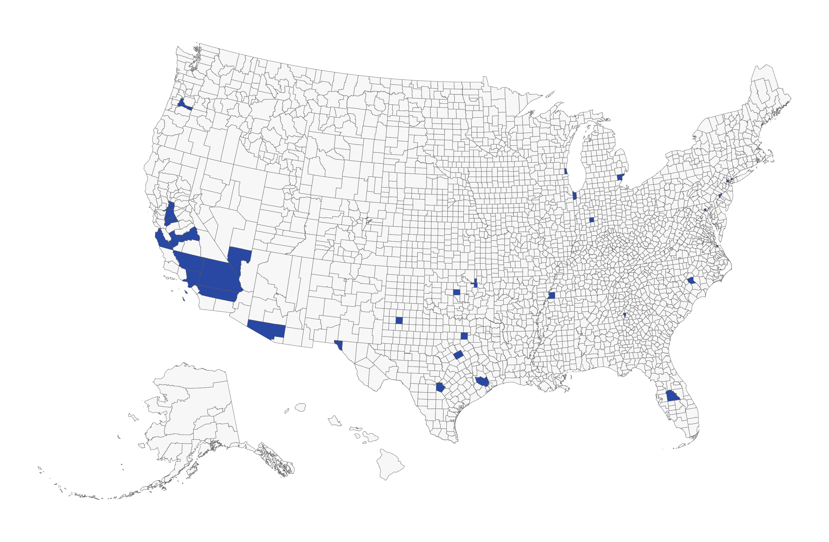
LEP Populations
Of the 315 high-vulnerability counties…
… 45 counties (14%) are also in the 90th percentile for LEP Chinese speakers.
… 54 counties (17%) are also in the 90th percentile for LEP Korean speakers.
…. 61 counties (19%) are in the 90th percentile for LEP Vietnamese speakers.
… 33 counties are in the 90th percentile for all LEP speakers of Asian languages.
Toyin Ola

Slide 8
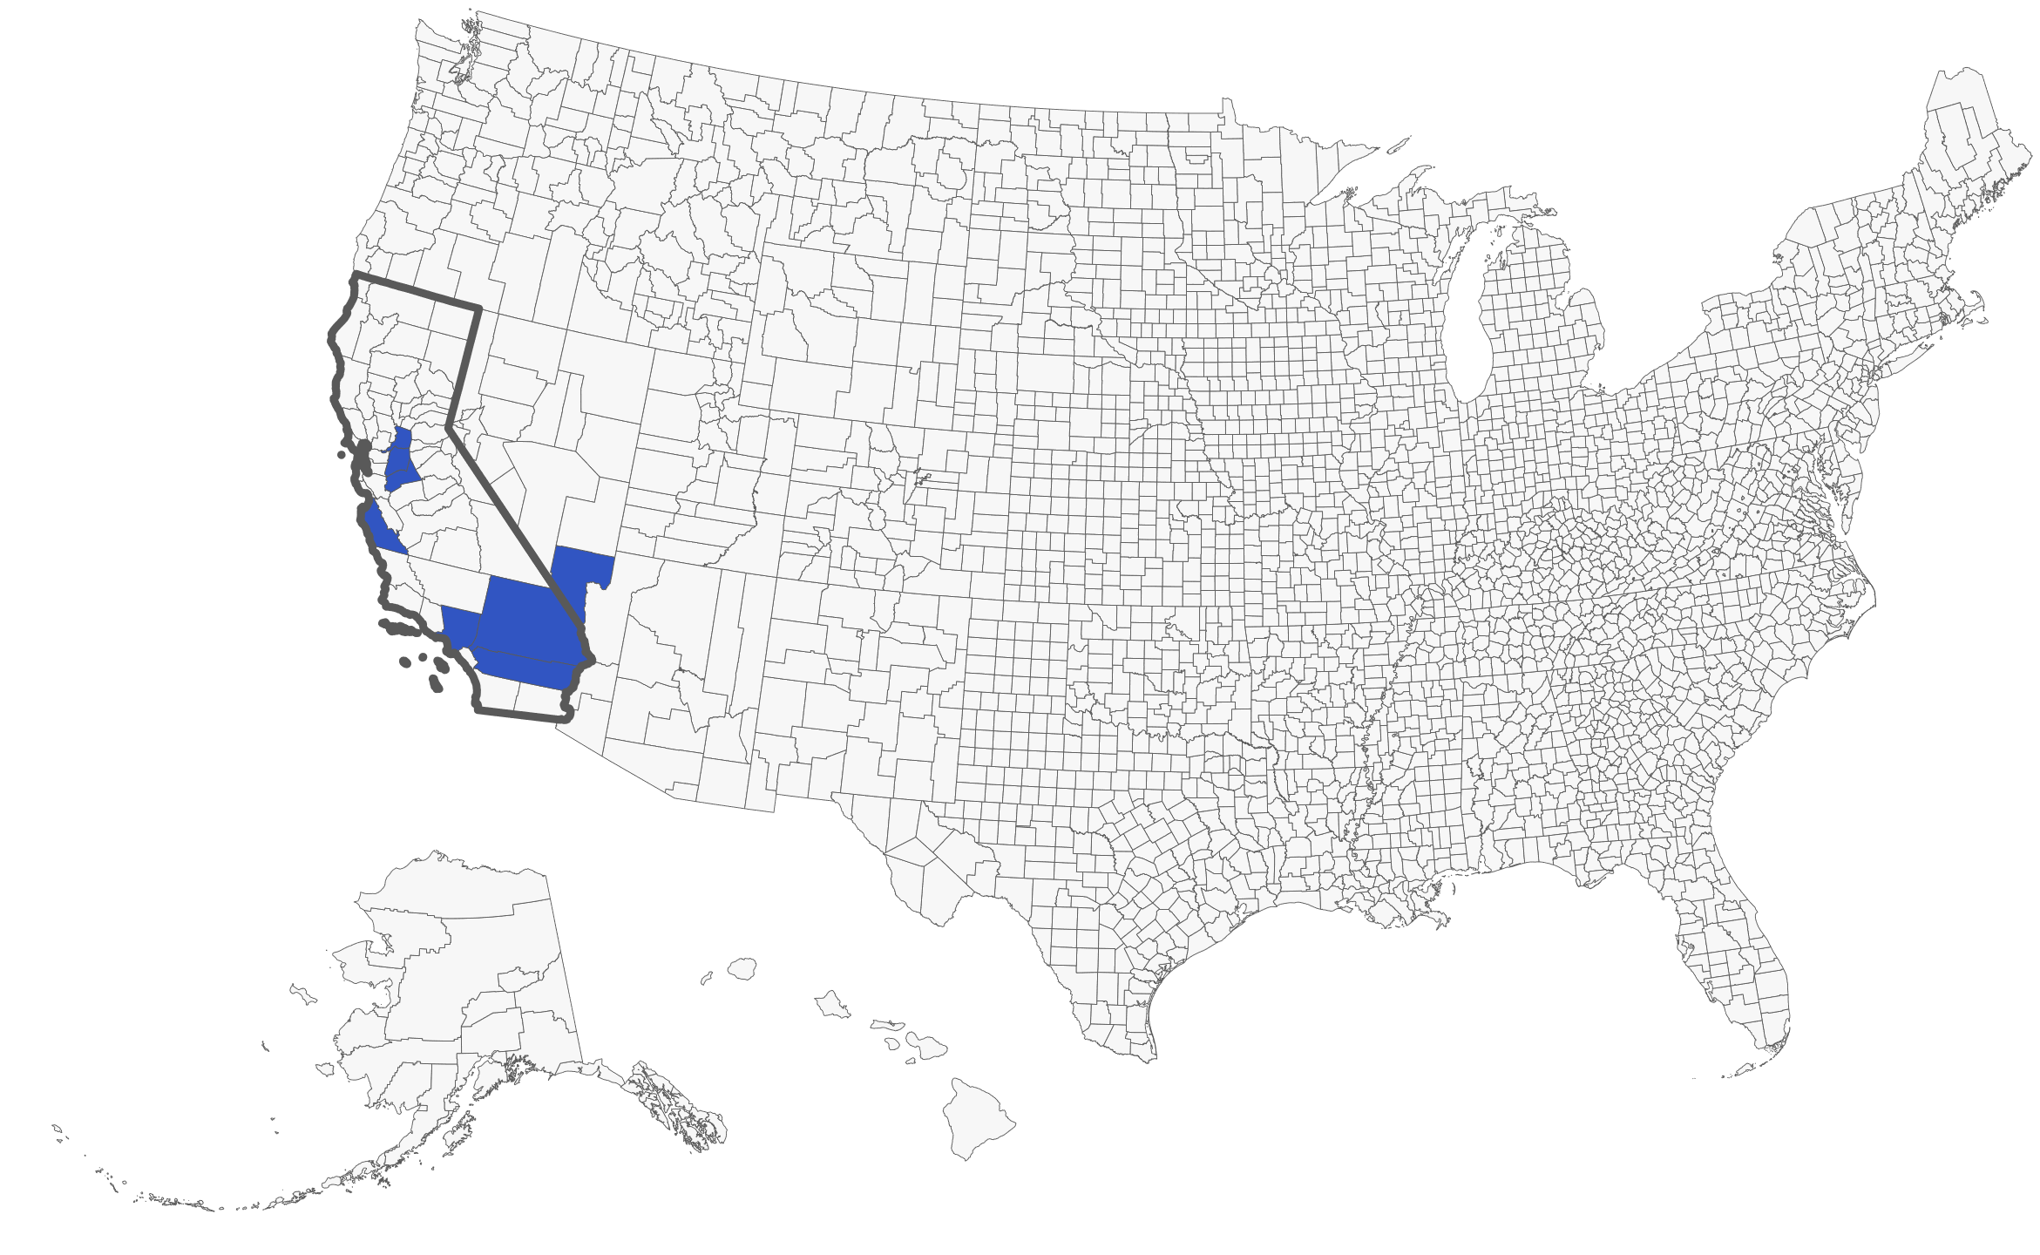
Intersections
There are only eight high-vulnerability counties at the intersection of all these variables (AA, NH, and PI populations and LEP Chinese, Korean, and Vietnamese speakers). Most are in California.
Toyin Ola
Notes:
Texas has the most high-vulnerability counties that are also in the 90th percentile for LEP Vietnamese speakers. For the other variables, California has the most high-vulnerability counties in that are also in the 90th percentile for each variable of interest.

